Slide 1
Calculation on domain and constraint (2) Report is in this file

Slide 2
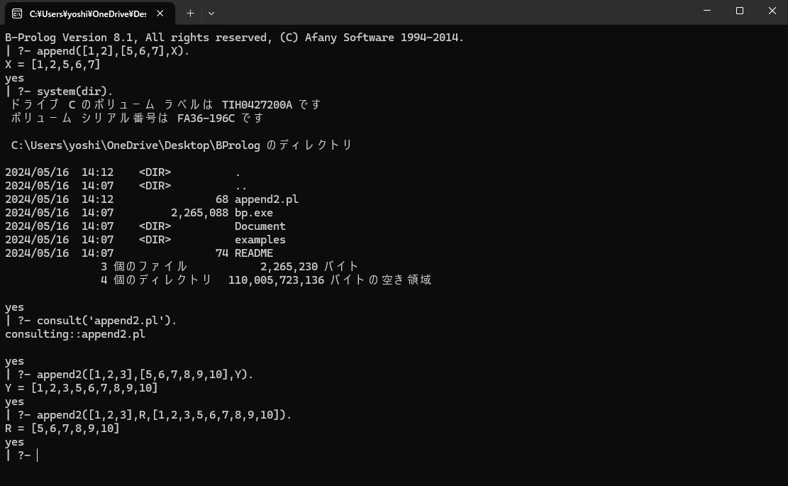
Recursion, again (usage of list)

Slide 3

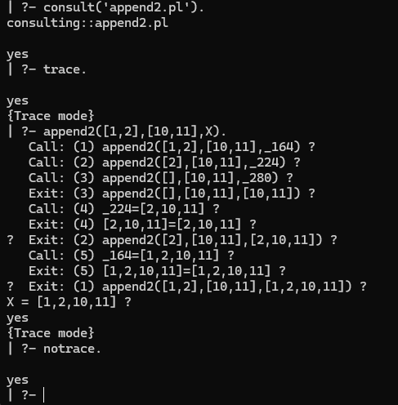

Slide 4
Predicates for CSP (finite domain)
Domain X :: 1..5 cf. member(X,[1,2,3,4,5]) [X,Y,Z] :: 1..5
Arithmetic constraint X+Y #= 1 X #=< 10

Slide 5
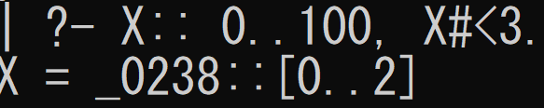
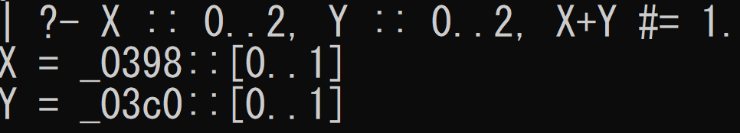
Predicates for CSP (finite domain)

Slide 6
Node consistency for binary CSPs
A primitive constraint c is node consistent with domain D if either |vars(c)|≠1 or, if vars(c)={x}, then for each d∈D(x),{x→d} is a solution of c. A CSP with constraint c1∧…∧cn and domain D is node consistent if each primitive constraint ci is node consistent with D for 1≦i≦n.

Slide 7
Arc consistency for binary CSPs
A primitive constraint c is arc consistent with domain D if either |vars(c)|≠2 or, if vars(c)={x,y}, then for each dx∈D(x), there is some dy∈D(y) such that {x→dx,y→dy} is a solution of c and for each dy∈D(y), there is some dx∈D(x) such that {x→dx,y→dy} is a solution of c. A CSP with constraint c1∧…∧cn and domain D is arc consistent if each primitive constraint ci is arc consistent with D for 1≦i≦n.

Slide 8
An example
X<Y ∧ Y<Z ∧ Z≦2
with the domain D where D(X)=D(Y)=D(Z)={1,2,3}
Is this node consistent? Or arc consistent?

Slide 9
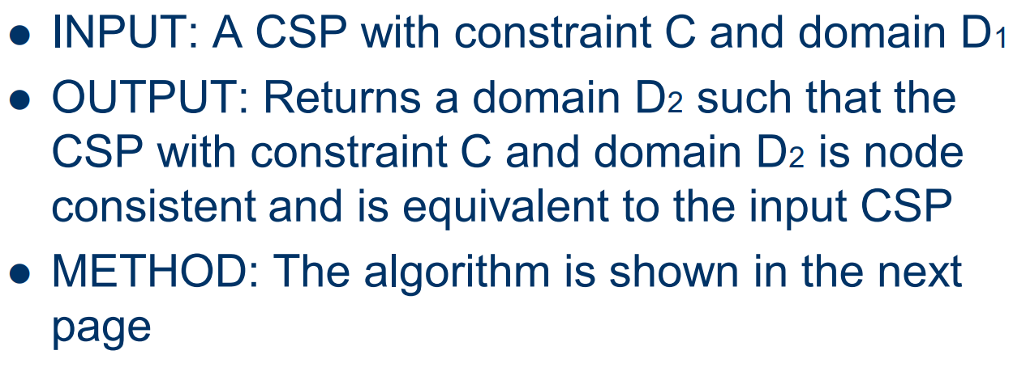

Slide 10
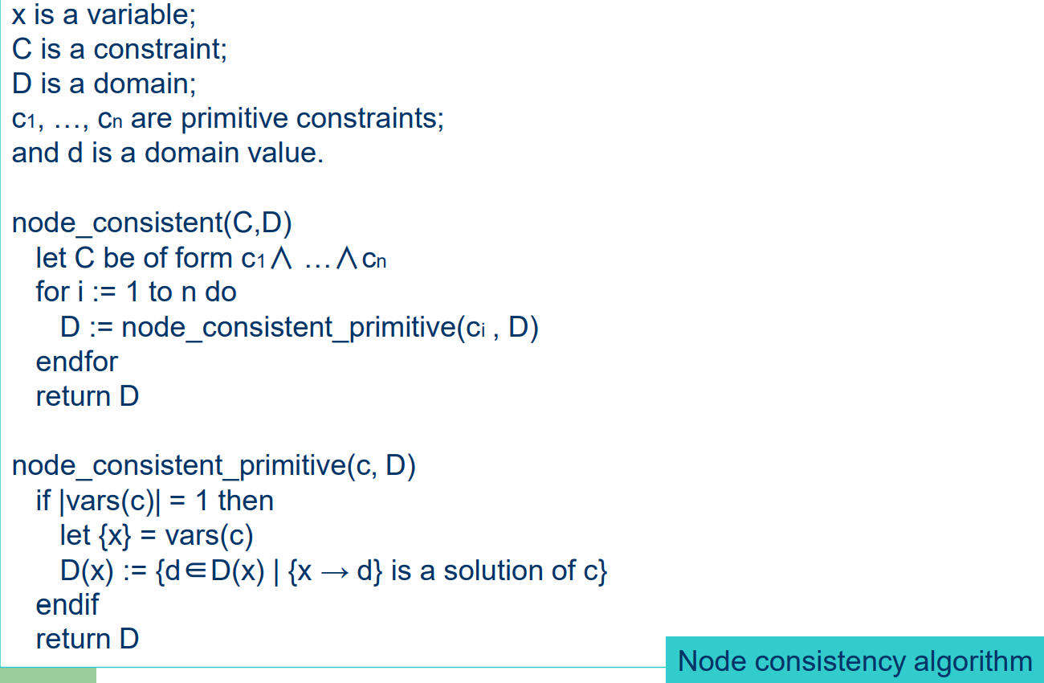

Slide 11
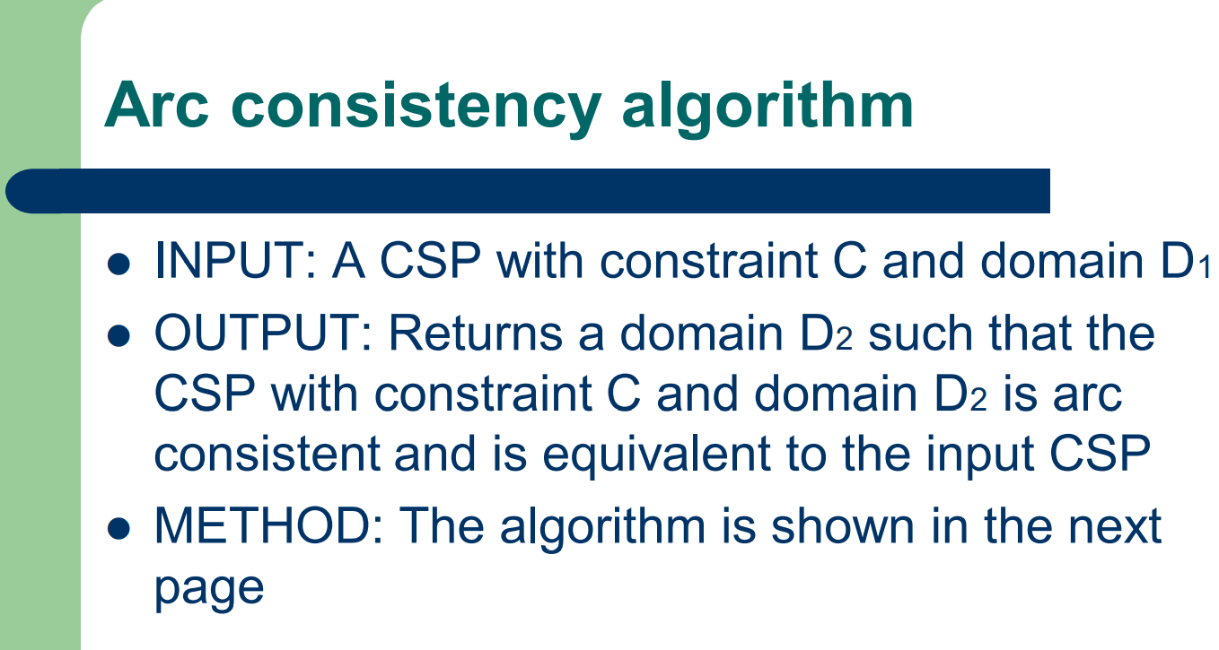
Report: Complete ‘METHOD’
Submission by email to yoshie@waseda.jp
Deadline: June 19th before the class begins
Email title: your student number
Attachment file (PDF) 1 page

